Slide 1
PHYS 304: Lecture 5 (Intro to) Quantum Mechanics
Sept-Dec 2021 Edition
Jeff Young
brimacombe Rm 278, young@phas.ubc.ca

Slide 2
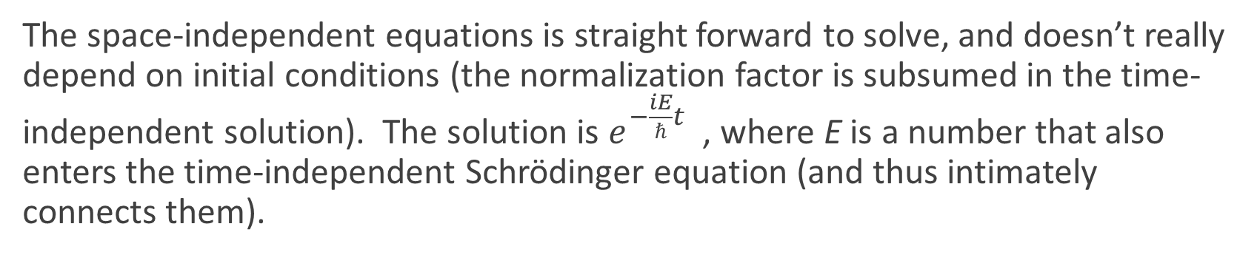
Review of Key points from last day
By using separation of variables, the partial differential, spatio-temporal Schrödinger equation reduces to two separate differential equations for the time- and space-independent Schrödinger equations.
The space-independent equations is straight forward to solve, and doesn’t really depend on initial conditions (the normalization factor is subsumed in the time-independent solution). The solution is $e^{−\frac{iE}{ℏ}t}$ , where E is a number that also enters the time-independent Schrödinger equation (and thus intimately connects them).

Slide 3
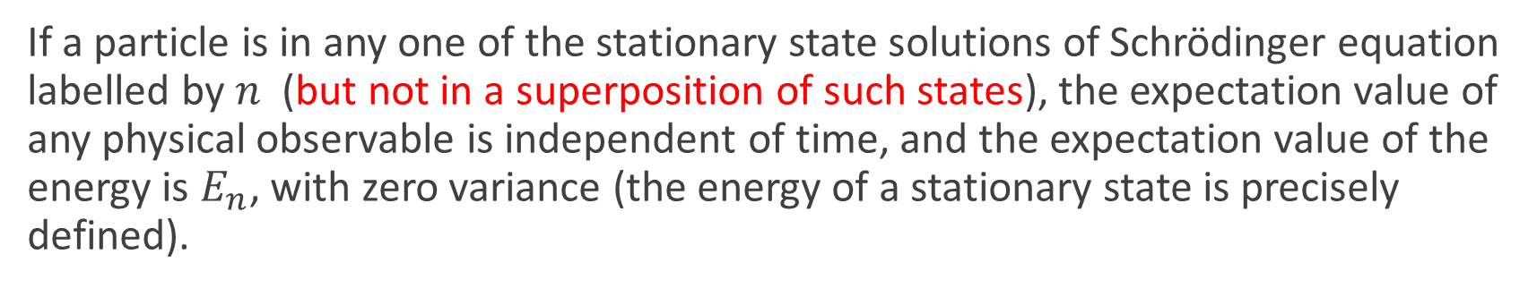
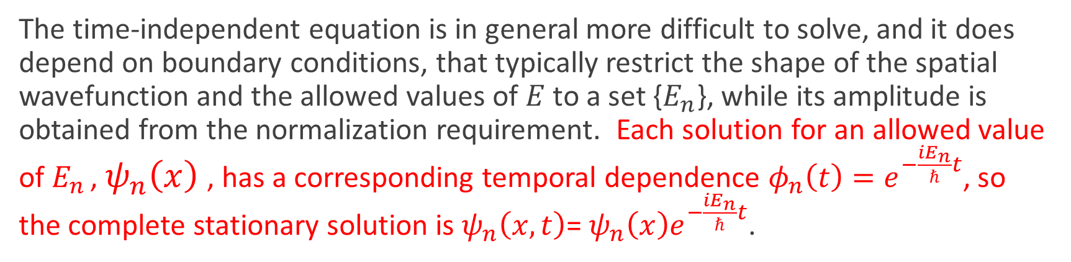
Review of Key points from last day
The time-independent equation is in general more difficult to solve, and it does depend on boundary conditions, that typically restrict the shape of the spatial wavefunction and the allowed values of $E$ to a set {$E_{n}$}, while its amplitude is obtained from the normalization requirement. Each solution for an allowed value of $E_{n}$ , $ψ_{n}\left(x\right)$, has a corresponding temporal dependence $φ_{n}\left(t\right)=e^{−\frac{iE_{n}}{ℏ}t}$, so the complete stationary solution is $ψ_{n}\left(x,t\right)$= $ψ_{n}\left(x\right)e^{−\frac{iE_{n}}{ℏ}t}$.
If a particle is in any one of the stationary state solutions of Schrödinger equation labelled by $n$ (but not in a superposition of such states), the expectation value of any physical observable is independent of time, and the expectation value of the energy is $E_{n}$, with zero variance (the energy of a stationary state is precisely defined).

Slide 4
Today: Solving the Schrödinger equation (the utility of stationary states in QM)
Crucially, the entire set of all solutions of the time-independent Schrödinger equation, with their corresponding values of E_{n} , form a complete orthonormal set of functions that can be used to expand an arbitrary spatially varying function defined in the region where the particles exist, satisfying the same boundary conditions.
The algorithm (flowchart) for solving the full Schrödinger equation using separation of variables is:

Slide 5
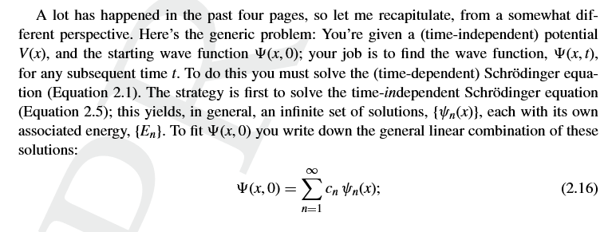
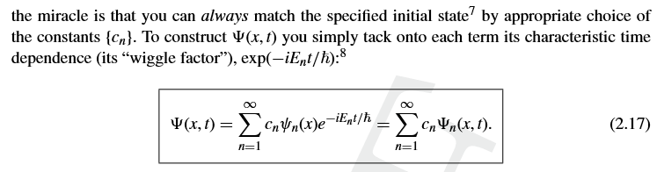
…from the text
Notes:
In the setup to the problem, tmphasize similarity to classical mechanics where have to be given the potential, and the position and velocity of the particle at t=0.
First step is to solve the time-independent SE
Then expand initial wavefunction in the eigen states of the TISE (emphasize similarity but generalization of Fourier series expansion that went through in tutorial yesterday)
Then emphasize the trivial nature of getting the full time-dependence, and also emphasize that the general WF is NOT harmonic

Slide 6
In recipe format: CRUCIAL CONCEPT
Notes:
Makes the time dependence part of a solution “trivial”.

Slide 7
First concrete example: the infinite square well potential
V=infinity
V=infinity
V=0
x=0
x=a

Slide 8

Step 1: Solve the time-independent SE
Lecture 5, Activity #1: [TPS, 10 mins]
Sketch the potential, V(x), for $−∞<x<∞$.
Solve the time-independent SE separately in the three regions: $x<0, 0<x<a, x>a$, leaving the solutions in their most general form, with unknown coefficients, at this stage.
Notes:
Sketch potential on board and/or on slide

Slide 9

Outside of the well
See hand-written solution when $V=∞$

Slide 10
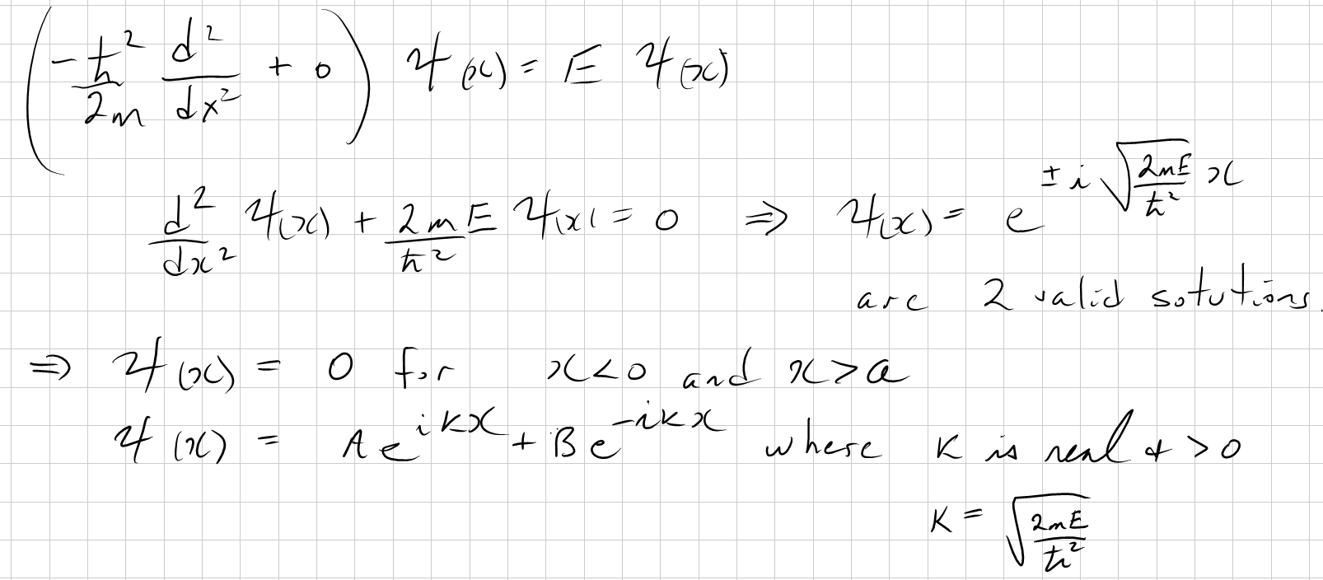
Infinite square well solutions of TISE
When V(x) is infinite, then classically and quantum mechanically, there is no probability that the particle can be located in that region. The implication is that the wavefunction must be zero in this problem, except for 0 < x < a, where V(x)=0. So:
For 0 < x < a, V=0, the time independent SE is:

Slide 11
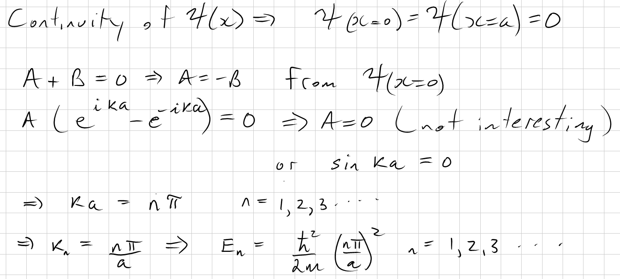
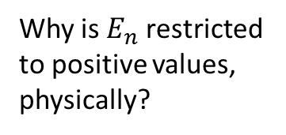
Solve the time-independent SE (con’t)
Lecture 5, Activity #2: [TPS, 5 mins]
Use the fact that the wavefunction has to be continuous in $−∞<x<∞,$to find the allowed values of $E_{n}$.
Why is $E_{n}$ restricted to positive values, physically?
Why did we not have to use the x=a boundary condition?
Notes:
Why can’t E be <=0?
E=0 boring (WF=0 everywhere)
E<0: can’t satisfy BCs, since real exponential functions

Slide 12

What do we now know about the solutions of the TISE for an infinite square well of width a?
$ψ_{n}(x)∝ sin(\frac{nπ}{a}x)$ since (A=-B), and the associated values of $E_{n}$ are $E_{n}=\frac{ℏ^{2}}{2m}{(\frac{nπ}{a})}^{2}$, $n$=1,2,… There are no other allowed values of $E!$
Next?

Slide 13
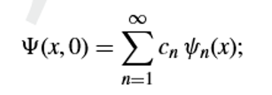
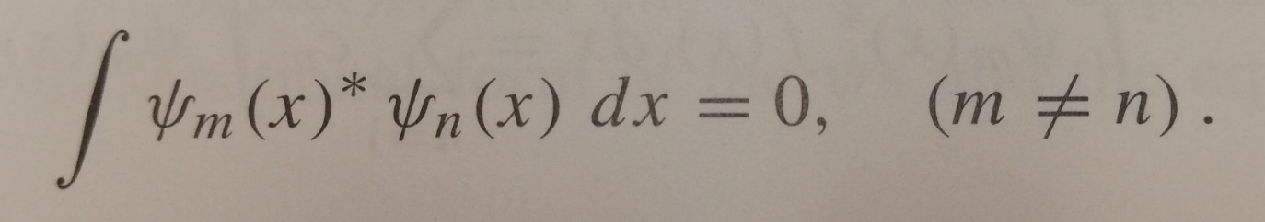
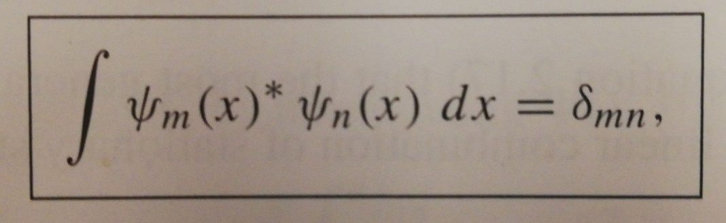
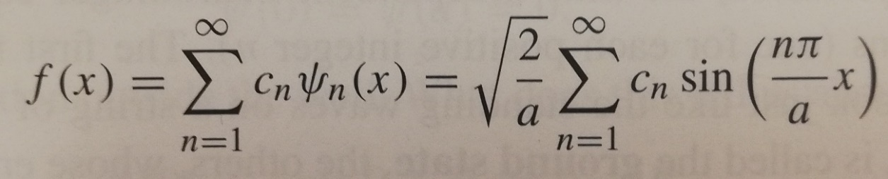
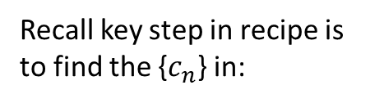
Orthogonal and Orthonormal Functions
Lecture 5, Activity #3: [Class discussion]
Recall key step in recipe is to find the {$c_{n}$} in:
What does it mean for two functions to be “orthogonal”? Write a defining equation. What is the difference between orthogonal and orthonormal?
What does it mean for a set of functions to be “complete”? Use equations and provide an explanation?
Notes:
Emphasize the similarity to 2D vector decomposition, and to Fourier series, but recognize this is more general now, since the expansion functions are solutions of TISE, not necessarily a set of harmonic sinusoids (although in this case they are a set of harmonic sinusoids!)
Emphasize unique set of Cn. “Math”, but crucial math.

Slide 14
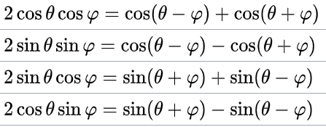

Orthogonal and Orthonormal Functions
Lecture 5, Activity #4: [TPS 5 mins + …]
Show that the $ψ_{n}(x)=\sqrt{\frac{2}{a}} sin(\frac{nπ}{a}x)$are orthonormal.

